Slide 1
Hooking Docker With Selenium

Slide 2
Agenda
What is Docker
Advantages
Frequently used Commands
How to hook Docker into Selenium?
Demo
Challenges

Slide 3

What is Docker??
An open source tool that can package an application and its dependencies such as libraries in a virtual container
Can run on any Linux server
Automates the deployment of applications inside software containers
YouTube Video: https://www.youtube.com/watch?v=pGYAg7TMmp0

Slide 4
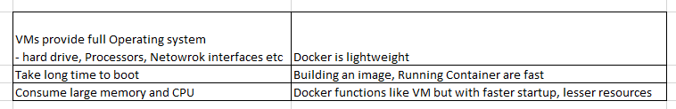
Advantages
No longer need a virtual machine spin up for each application
Greater portability (Solves the problem of Shipping code from one machine to another)
Lesser resources
Virtual Machines Vs Docker

Slide 5
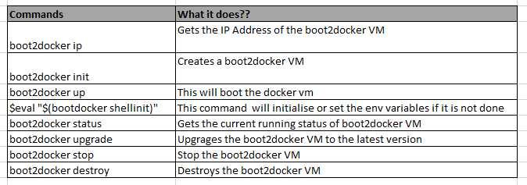
Boot2Docker Commands:
Docker sits on top of Linux kernel and inorder to access it from Windows or Mac OS , we need to install boot2docker
Download Location:
https://github.com/boot2docker/windows-installer/releases
Notes:
Docker sits on top of linux kernal.
Boot2 docker is a lightweight linux distribution made to run Docker Containers. It runs completely from RAM
Environment Variables:
Name: DOCKER_CERT_PATH
Value: C:\Users\XXX\.boot2docker\certs\boot2docker-vm
Name: DOCKER_HOST
Value: tcp://192.168.59.103:2376
Name:DOCKER_TLS_VERIFY
Value: 1

Slide 6
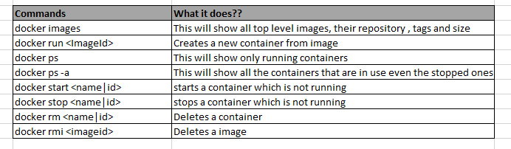
Docker Commands
Once the boot2docker VM is up and running , you can use the below commands
Command list:
https://docs.docker.com/reference/commandline/run/

Slide 7
Hook Docker into Selenium
Download the Images to your local:
Hub (Server):
docker pull selenium/hub:latest
Nodes (Browsers):
docker pull selenium/node-chrome:2.44.0
docker pull selenium/node-chrome:2.45.0
docker pull selenium/node-chrome:latest
Export the images to an archive(.tar file) if needed
docker save -o ~/Downloads/docker_selenium_hub.tar selenium/hub
docker save –o ~/Downloads/docker_selenium_node_chrome.2.46.0.tar selenium/node-chrome:2.46.0
Load the images from the .tar file
docker load --input ~/Downloads/docker_selenium_hub.tar
All these images are maintained by Selenium development team
https://github.com/SeleniumHQ/docker-selenium
https://hub.docker.com/

Slide 8
Running the Selenium Grid/Node
Start your Selenium Grid (Registering the Hub and the Nodes)
docker run -d -p 4444:4444 --name selenium-hub selenium/hub
docker run -d --link selenium-hub:hub selenium/node-chrome:2.45.0
Verify if your grid is running
bootdocker ip (192.168.59.103)
http://192.168.59.103:4444/grid/console

Slide 9
Demo
Run a Sample UI acceptance test by pointing the hub address to be boot2docker ip address

Slide 10
Challenges
Legacy app with too many dependencies and complexities may not be suitable
Still in the Early phase
Latency between boot2docker and Linux kernel
Eg:Starting or Stopping or Removing a container do have latency issues

Slide 11
Q & A???

